Slide 1
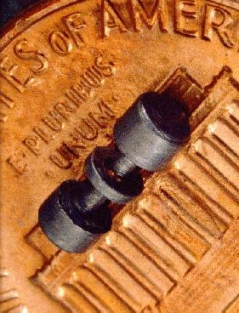
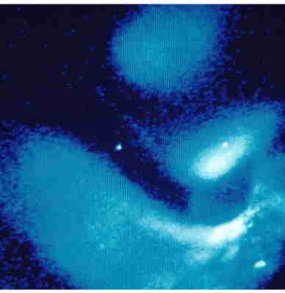
Single-atom optical clocks
D. J. Wineland, NIST, Boulder
Hg⁺ ion

Slide 2
Single-atom optical clocks
D. J. Wineland, NIST, Boulder
Summary
Why precise clocks?
Atomic clock basics
Optical atomic clocks
  - atomic ion examples
  (neutral atoms good too)
Why single atoms?
State of play
Future
Hg⁺ ion

Slide 3
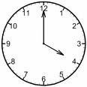
Why precise clocks?
Navigation: e.g. satellite navigation (GPS)
pulse emitted at t₀
ℓ
pulse received at t₁
ℓ = c x (t₁ – t₀)
error: δℓ = c δt
for δt = 10⁻⁹ s, δℓ ≅ 30 cm
(δt)/(1 day) = 10⁻¹⁴ ≅ δf/f₀

Slide 4
Global positioning system GPS
satellite network
gives 3 space
dimensions
+ time

Slide 5

Clocks
periodic-event
generator
Traditional periodic event-generators,
or frequency references:
pendulum clock
counter
TexPoint fonts used in EMF.
Read the TexPoint manual before you delete this box.:

Slide 6

Atomic energy state superpositions act like pendulum clock
|2⟩
superposition of
electron energy levels,
wave function:
Ψ = |1⟩ + exp(-i2πf₀t) |2⟩
oscillating electric dipole
Energy →
|1⟩
at frequency f₀ = (E₂ – E₁)/h
center
of atom
Planck’s constant
plot of electron density vs. time

Slide 7
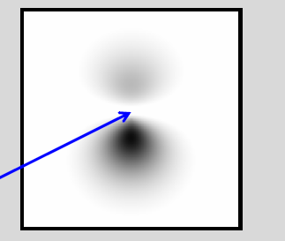
Atomic energy state superpositions act like pendulum clock
|2⟩
superposition of
electron energy levels,
wave function:
Ψ = |1⟩ + exp(- i2πf₀t) |2⟩
oscillating electric dipole
Energy →
|1⟩
at frequency f₀ = (E₂ – E₁)/h
center
of atom
Planck’s constant
plot of electron density vs. time
Practical mode of operation:
1. Start atom in |1⟩.
|2⟩
2. Apply radiation at frequency f_{L} for short time.
3. Measure probability of | 2⟩.
Maximum | 1⟩ → | 2⟩ transition probability when f_{L} = f₀ .
|1⟩

Slide 8
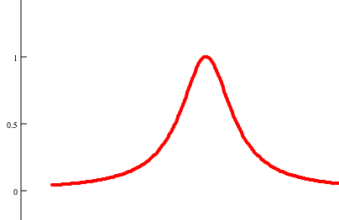
Atomic clock recipe
electronic feed back servo
absorption →
f →
radiation source
frequency f
f₀
detector
2
1
transparent cell (“trap”)
containing atoms
counter

Slide 9
Why atomic clocks?
Pendulum:
ℓ
f = [g/ℓ]^{1/2}/2π
Atoms:
gravitational
acceleration
Environmental sensitivity:
(e.g. temperature T)
Environmental sensitivity:
(e.g. temperature T)
relativistic time dilation:
(f₀(T) – f₀(T = 0))/f₀ = -½⟨(v/c)²⟩
≅ -1.4 x 10⁻¹³ T/M(u)
δf/f₀ = - ½ α (δT)
coefficient of thermal expansion:
δℓ = ℓ α (δT)
low expansion materials: α ~ 10⁻⁸/◦C
⇒ δf/f₀ ≅ -5 x 10⁻⁹/ ◦C
For M = 133 u (e.g., ¹³³Cs – Cesium)
δf/f₀ ≅ -1 x 10⁻¹⁵/ ◦C
Reproducibility:
f₀ depends on:
◊ manufacturing tolerances (ℓ)
◊ local value of g
◊ wear
Reproducibility:
◊ all atoms of a particular kind
(e.g., ¹³³Cs ) are identical!
◊ atoms don’t wear out!

Slide 10
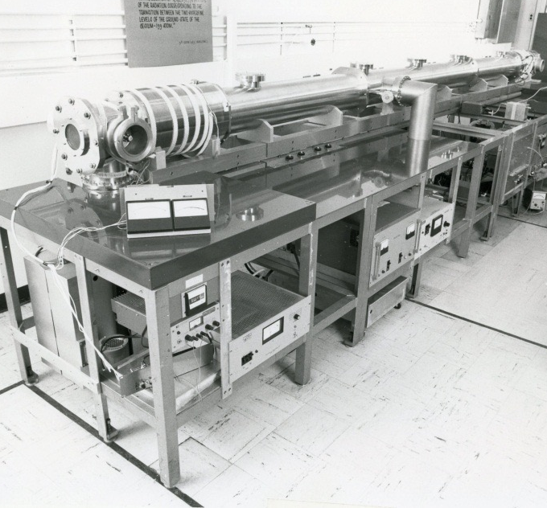
Atomic beam spectrometer
Δf = 1/(2T_{transit})
μ-waves
absorption →
f₀
μ -wave cavity
(Ramsey method)
count
atoms
atomic beam
state preparation
(e.g. laser optical pumping)
state detection
(e.g., state-dependent
fluorescence)
Δ f ~ 1/(2T_{transit})
e.g., Cesium beam clock (hyperfine trans.)
f₀ ≡ 9 192 631 770 Hz (microwaves)
e.g., NBS-6 (~ 1976)
L = 3.75 m, Δ f ≅ 30 Hz (T_{transit} ~ 16 ms)

Slide 11
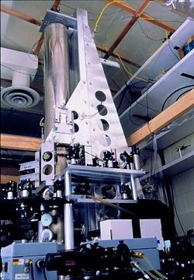
Atomic beam spectrometer
Δ f = 1/(2T_{transit})
μ -waves
absorption→
f₀
μ -wave cavity
(Ramsey method)
count
atoms
atomic beam
state preparation
(e.g. laser optical pumping)
state detection
(e.g., state-dependent
fluorescence)
Atomic fountain
NIST F-1
μ -waves
T_{transit} ≅ 1 s
atom cooling,
state preparation & detection

Slide 12
tick rate can be fast; e.g., for ¹⁹⁹Hg⁺ ( ²S_{1/2} ↔ ²D_{5/2})
f₀ = 1 064 721 609 899 144.94 (97) Hz
absorption range very narrow
e.g., for ¹⁹⁹Hg⁺ , Δf₀ ≅ 1.6 Hz
Why optical atomic clocks?
From 1879 text written by Thompson (Lord Kelvin) and Tate,
(Idea attributed to Maxwell)
``The recent discoveries … indicate to us natural standard pieces of matter such as atoms of hydrogen or sodium, ready made in infinite numbers, all absolutely alike in every physical property. The time of vibration of a sodium particle corresponding to any one of its modes of vibration is known to be absolutely independent of its position in the universe, and it will probably remain the same so long as the particle itself exists."
W. F. Snyder, “Lord Kelvin on atoms as fundamental natural standards
(for base units)” IEEE Trans. Instrum. Meas., 99, 1973.

Slide 13
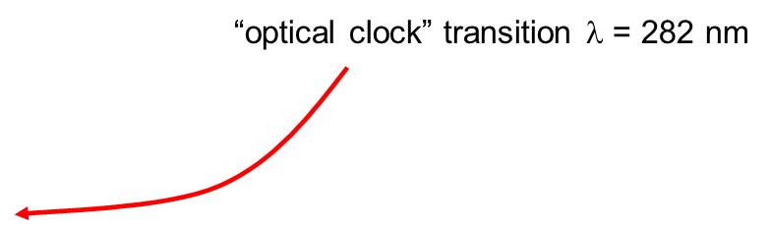
Hg⁺ ion optical clock experiments at NIST (1981 → )
τ = 0.1 s
“trap” electrodes
²D_{5/2}
²S_{1/2}
282 nm
1 mm
¹⁹⁹Hg⁺

Slide 14
Why just one ion? (single ions ⇒ smallest systematic errors)
τ = 0.1 s
“trap” electrodes
²D_{5/2}
²S_{1/2}
1 mm
for two ions,
quadrupole shift ~ 1 kHz

Slide 15
Single Hg⁺ ion optical clock experiments at NIST,1981 →
²P_{1/2}
“trap” electrodes
Hg⁺
²S_{1/2}
Laser cooling
194 nm
194 nm
1 mm
¹⁹⁹Hg⁺
Single Hg⁺ ion

Slide 16
Single Hg⁺ ion optical clock experiments at NIST,1981 →
τ = 0.1 s
“trap” electrodes
²D_{5/2}
²S_{1/2}
282 nm
1 mm
¹⁹⁹Hg⁺

Slide 17
Detection:
²P_{1/2}
“trap” electrodes
²D_{5/2}
Hg⁺
²S_{1/2}
cooling
and detection!
194 nm
1 mm

Slide 18
Detection:
²P_{1/2}
“trap” electrodes
²D_{5/2}
Hg⁺
²S_{1/2}
194 nm
1 mm
¹⁹⁹Hg⁺

Slide 19
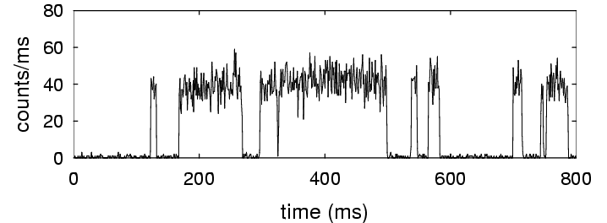
²P_{1/2}
“trap” electrodes
²D_{5/2}
Hg⁺
²S_{1/2}
atom in ²S_{1/2} state
atom in ²D_{5/2} state
1 mm

Slide 20
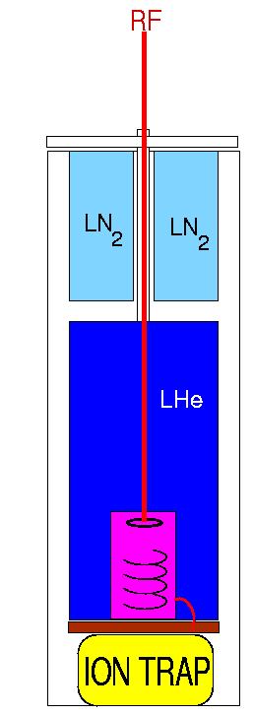
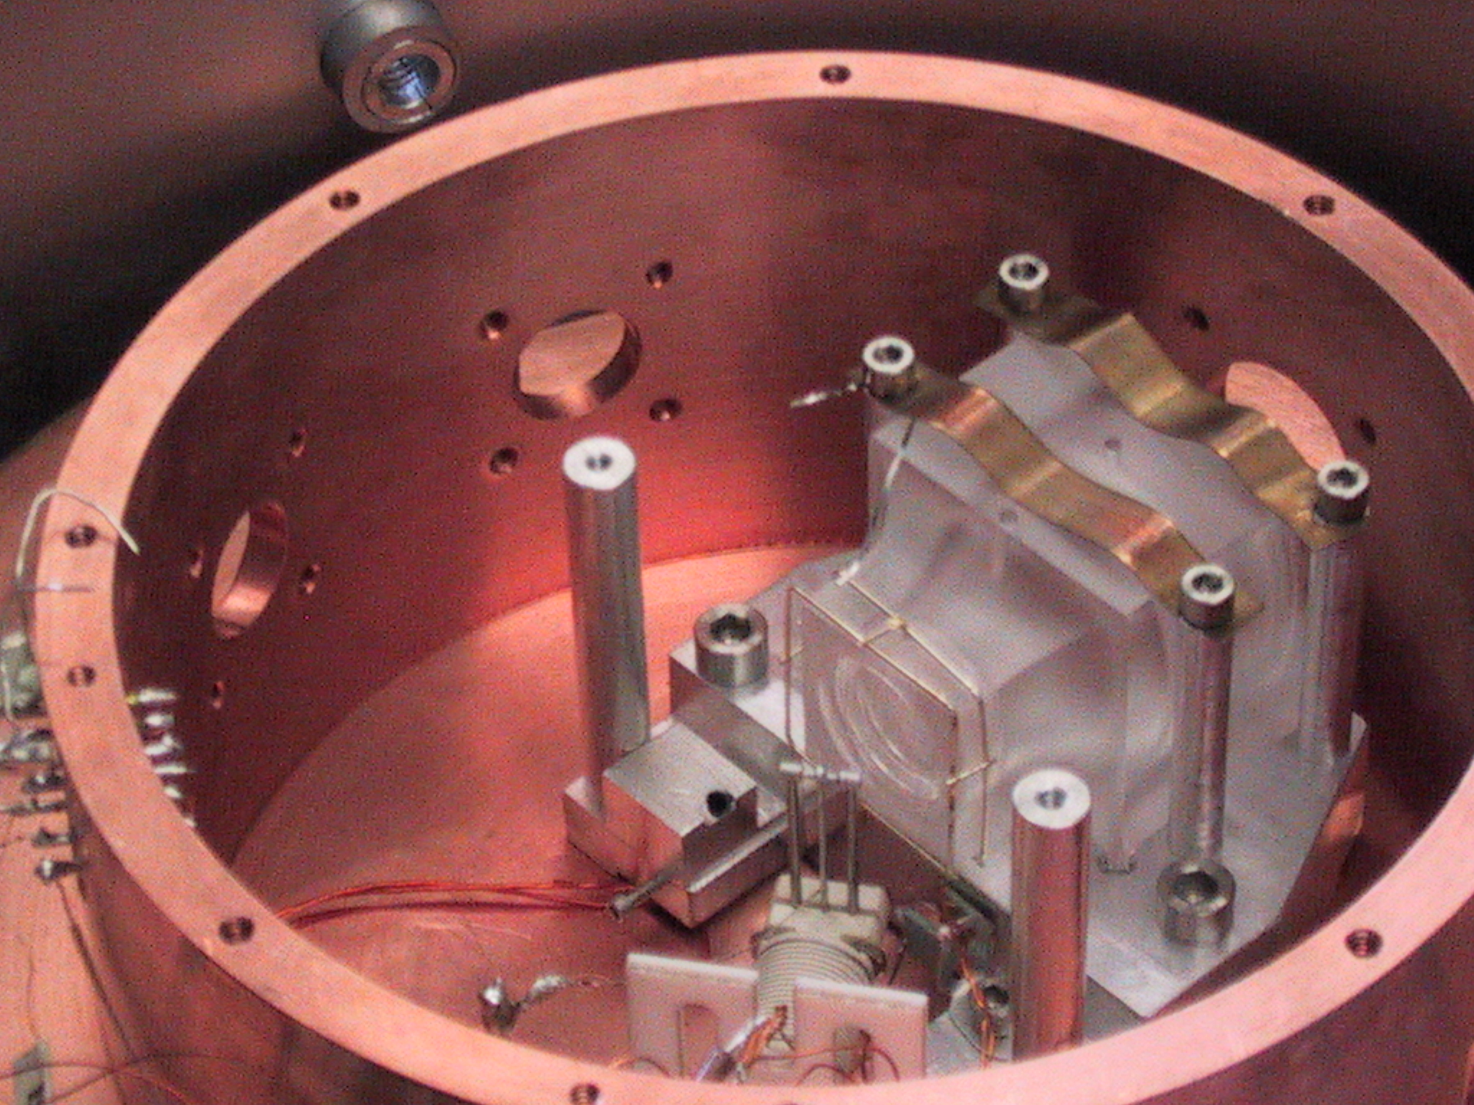
Ion “trap” in vacuum at liquid Helium temperature ( 4 K)
suppresses ion loss (T_{storage} ~ 6 months)
suppresses heating, perturbations
from collisions
reduces blackbody radiation shifts
imaging
lens
trap

Slide 21
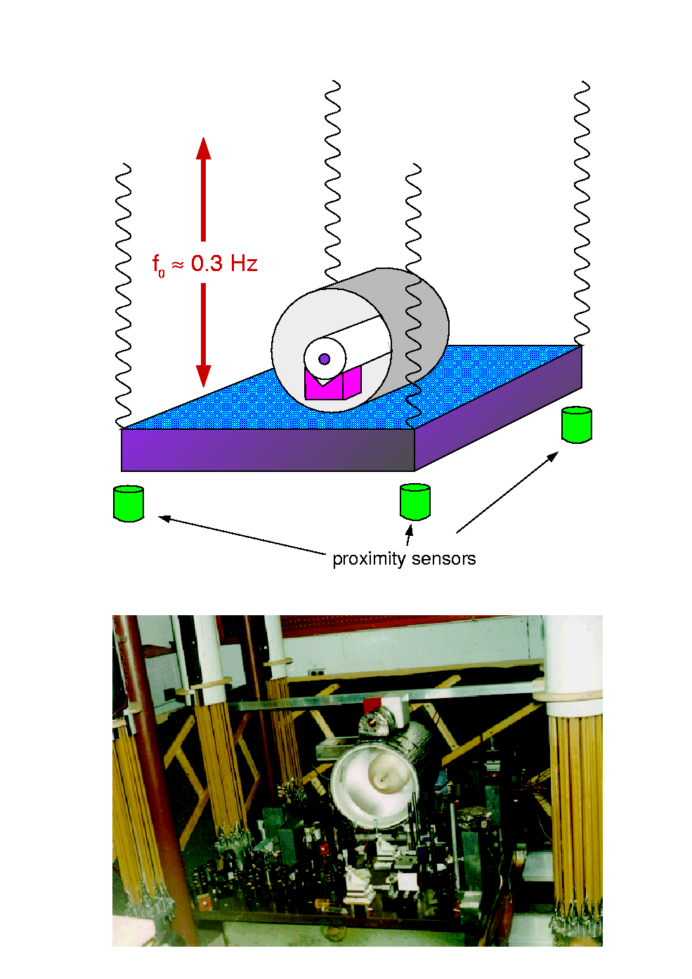
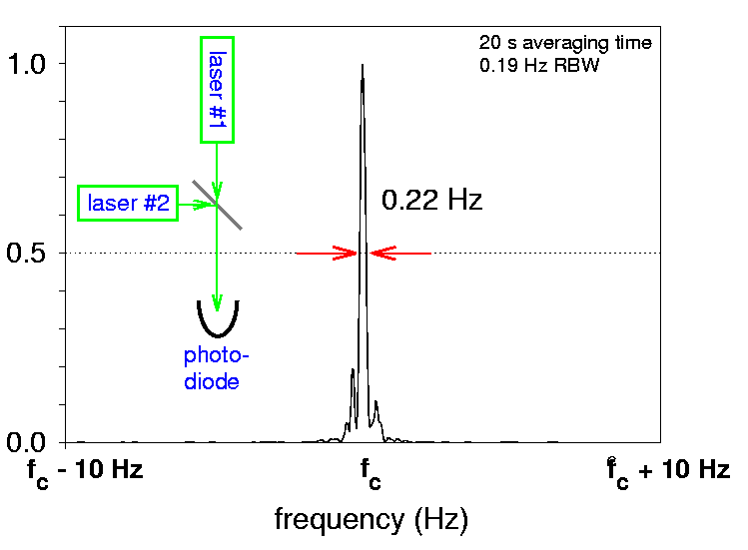
laser stabilization:
2-mirror resonant cavity:
distance = integer number of
half- wavelengths
averaging time
= 20 s
proximity sensors
λ = 563 nm
Brendt Young, Flavio Cruz, Wayne Itano,
Jim Bergquist , PRL 82, 3799 (1999) + ICOLS ‘99

Slide 22
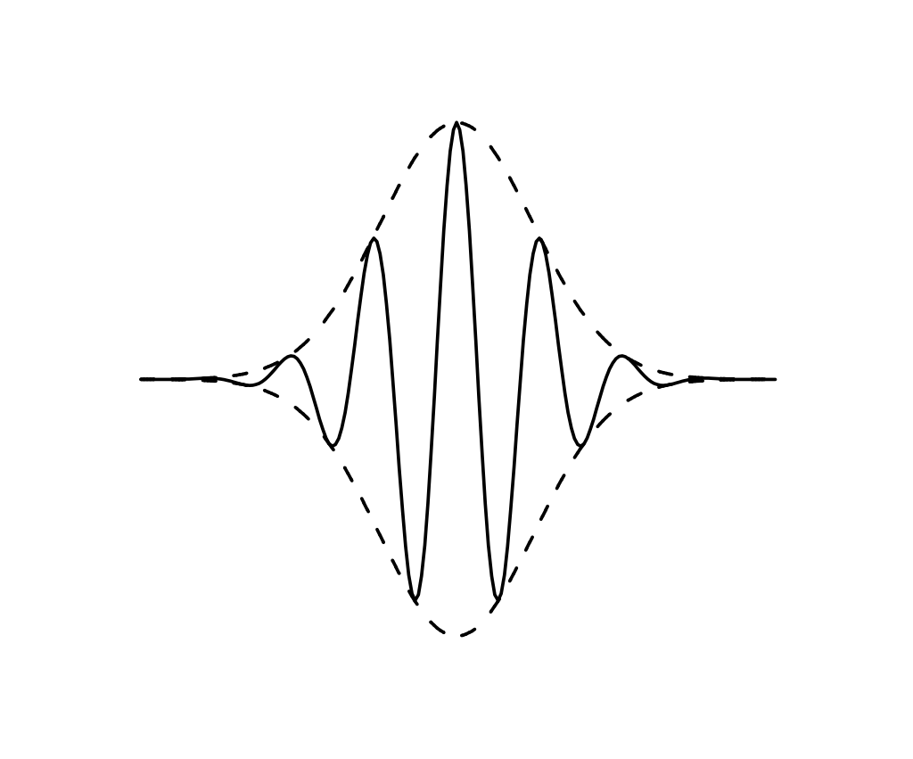
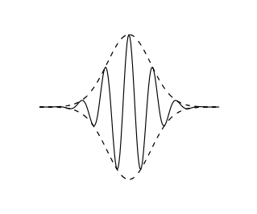
Frequency counters, > 2000
E(t)
Mode-locked laser
synchronize carrier phase with pulse phase
t
Frequency domain
I(f)
f_{r}
f
0
f₁
f₂
feed back on
laser to make
f_{beat} → 0
f₂ = 2 f₁
f₁ = M f_{r}
!
X 2
f_{beat}
T. Hänsch, J. Hall et al.

Slide 23
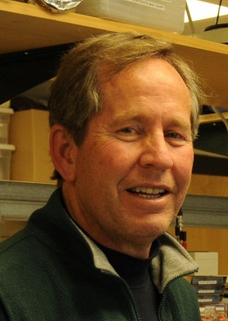
Single ¹⁹⁹Hg⁺ ions for (optical) clocks:
J. C. Bergquist et al., (NIST)1981 →
²P_{1/2}
²D_{5/2}
Hg⁺
²S_{1/2}
Jim Bergquist
trapping ⇒ first-order Doppler shift → 0
laser cooling ⇒ time dilation small
trapping in high vacuum at 4 K
⇒ small environmental perturbations (collisions, black body shifts, etc.)
⇒ first clock with systematic uncertainly (7x10⁻¹⁷) below Cesium
- W. H. Oskay et al., Phys. Rev. Lett. 97, 020801 (2006)

Slide 24
Single ¹⁹⁹Hg⁺ ions for (optical) clocks:
J. C. Bergquist et al., (NIST)1981 →
²P_{1/2}
²D_{5/2}
Hg⁺
²S_{1/2}
Jim Bergquist
Plus several other ion species:
⁸⁸Sr⁺, ¹⁷¹Yb⁺, ²⁷Al⁺, ⁴⁰Ca⁺, ¹¹⁵In⁺
see, e.g., A. Ludlow et al., arXiv:1407.3493
• trapping ⇒ first-order Doppler shift → 0
• laser cooling ⇒ time dilation small
• trapping in high vacuum at 4 K
⇒ environmental perturbations (collisions, black body shifts, etc.) small
²²⁹Th³⁺
(PTB, UCLA
Kuzmich group)
⇒ first clock with systematic uncertainly (7x10⁻¹⁷) below Cesium
- W. H. Oskay et al., Phys. Rev. Lett. 97, 020801 (2006)

Slide 25
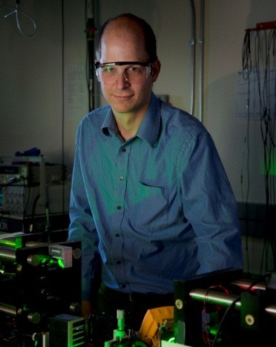
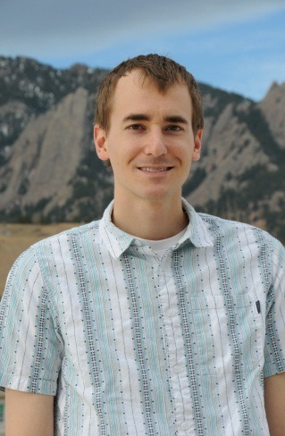

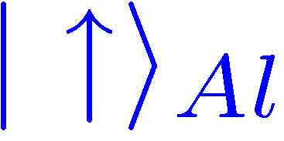
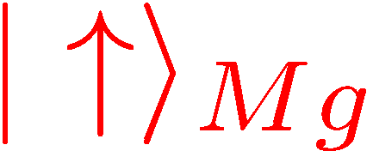
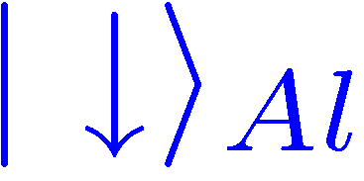
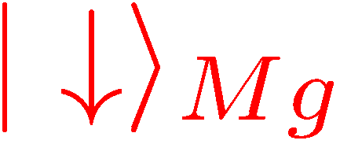
Al⁺ “quantum-logic clock” (T. Rosenband, D. Lebrandt et al.)
Coulomb
interaction
trap at
~ 300 K
¹P₁
²P_{3/2}
³P₀
Till Rosenband
David Leibrandt
λ = 280 nm
Al⁺
(F=2, m_{F} = -2)
λ = 167 nm
²⁵Mg⁺
²S_{1/2}
¹S₀
(F=3, m_{F} = -3)
α|↓⟩_{Al} + β|↑⟩_{Al} → motion superposition → α|↓_{Mg} + β|↑⟩_{Mg}
◊ laser-cooled Mg⁺ keeps Al⁺ cold
◊ Mg⁺ helps to calibrate ⟨B²⟩ from all sources
◊ collisions observed by ions switching places
◊ ……
P. O. Schmidt et al.,Science 309, 749 (2005)

Slide 26
Systematic frequency shifts
Example: relativistic effects in measurement
Doppler shifts: Δf/f₀ = ⟨v⟩/c – ½ ⟨v²⟩/c²
⟨v⟩/c: (“first-order” Doppler shift)
for Δf/f₀ = 10⁻¹⁸ ⇒ |⟨v⟩| = 0.3 nm/s
◊ trap vs. probe laser? Remove as in spacecraft ranging
(Bob Vessot, Ed Mattison et al., PRL 45, 2081 (1980))
– ½ ⟨v²⟩/c² : (time dilation shift)
suppressed with laser cooling
with all systematic errors,
uncertainty (²⁷Al⁺) = 8.0 x 10⁻¹⁸
gravitational-potential red shift Δf/f₀ = Δ Φ_{grav}/mc² = g_{local}Δh/c²
⇒ 2nd twin paradox
after 80 years, your twin (at sea level)
would be 1/1000 second younger

Slide 27
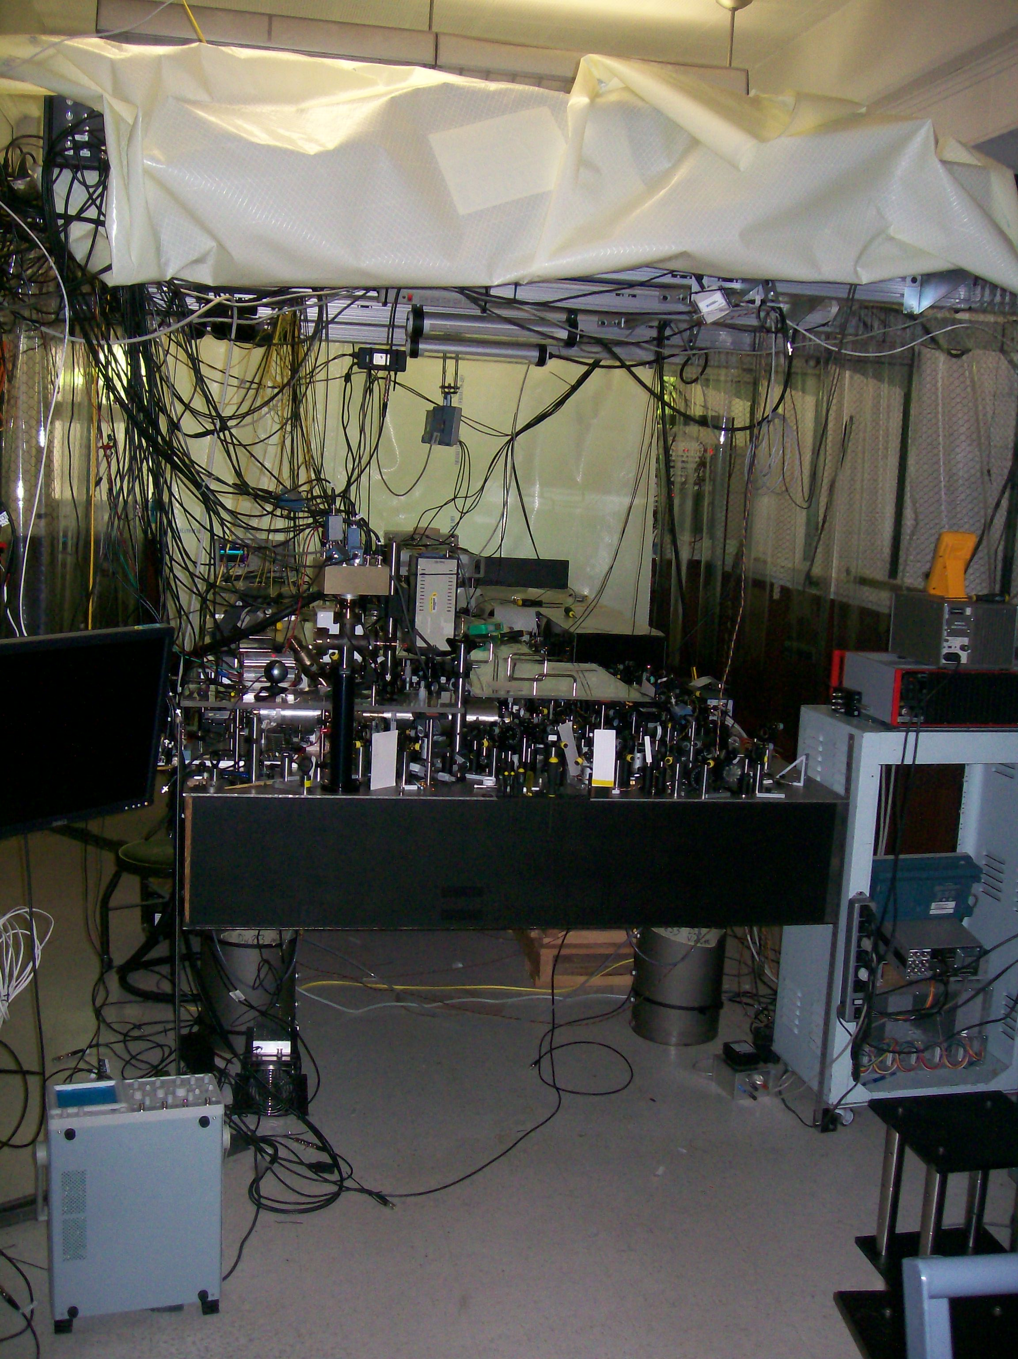
Some fun science:
Clocks and “relativity”
single Al⁺ ion clock (pre-wristwatch model)

Slide 28
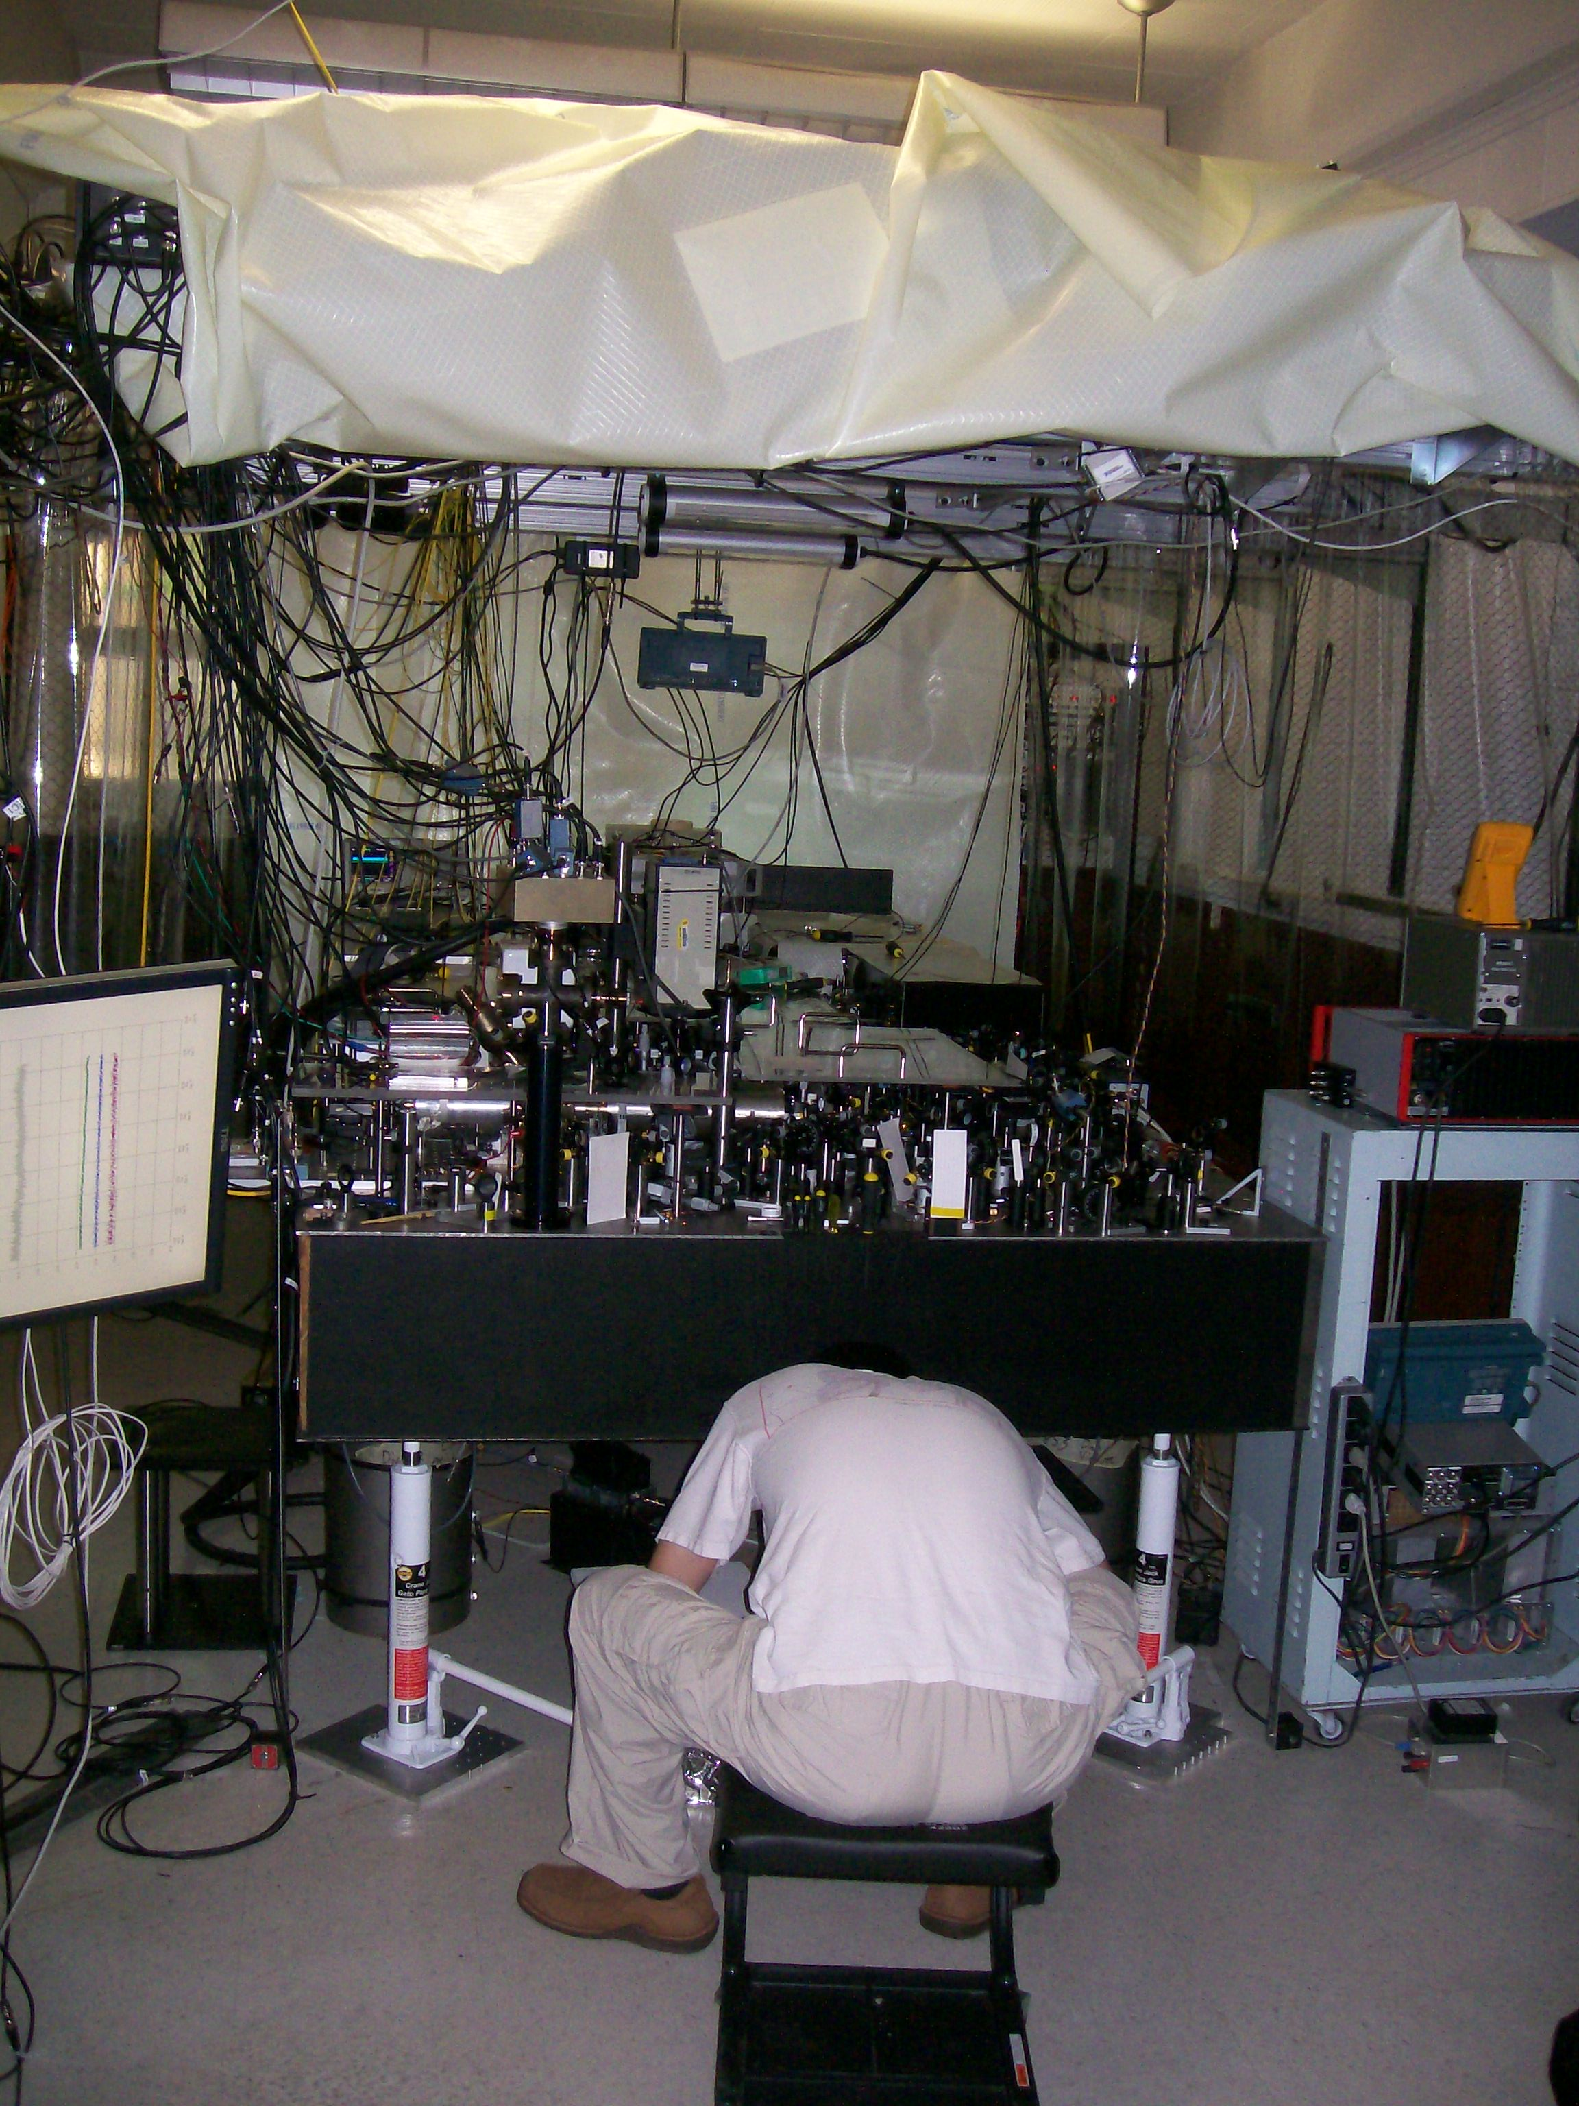
James Chou with “portable” Al⁺ clock (clock #1)
(reference clock in adjacent room, clock #2)

Slide 29
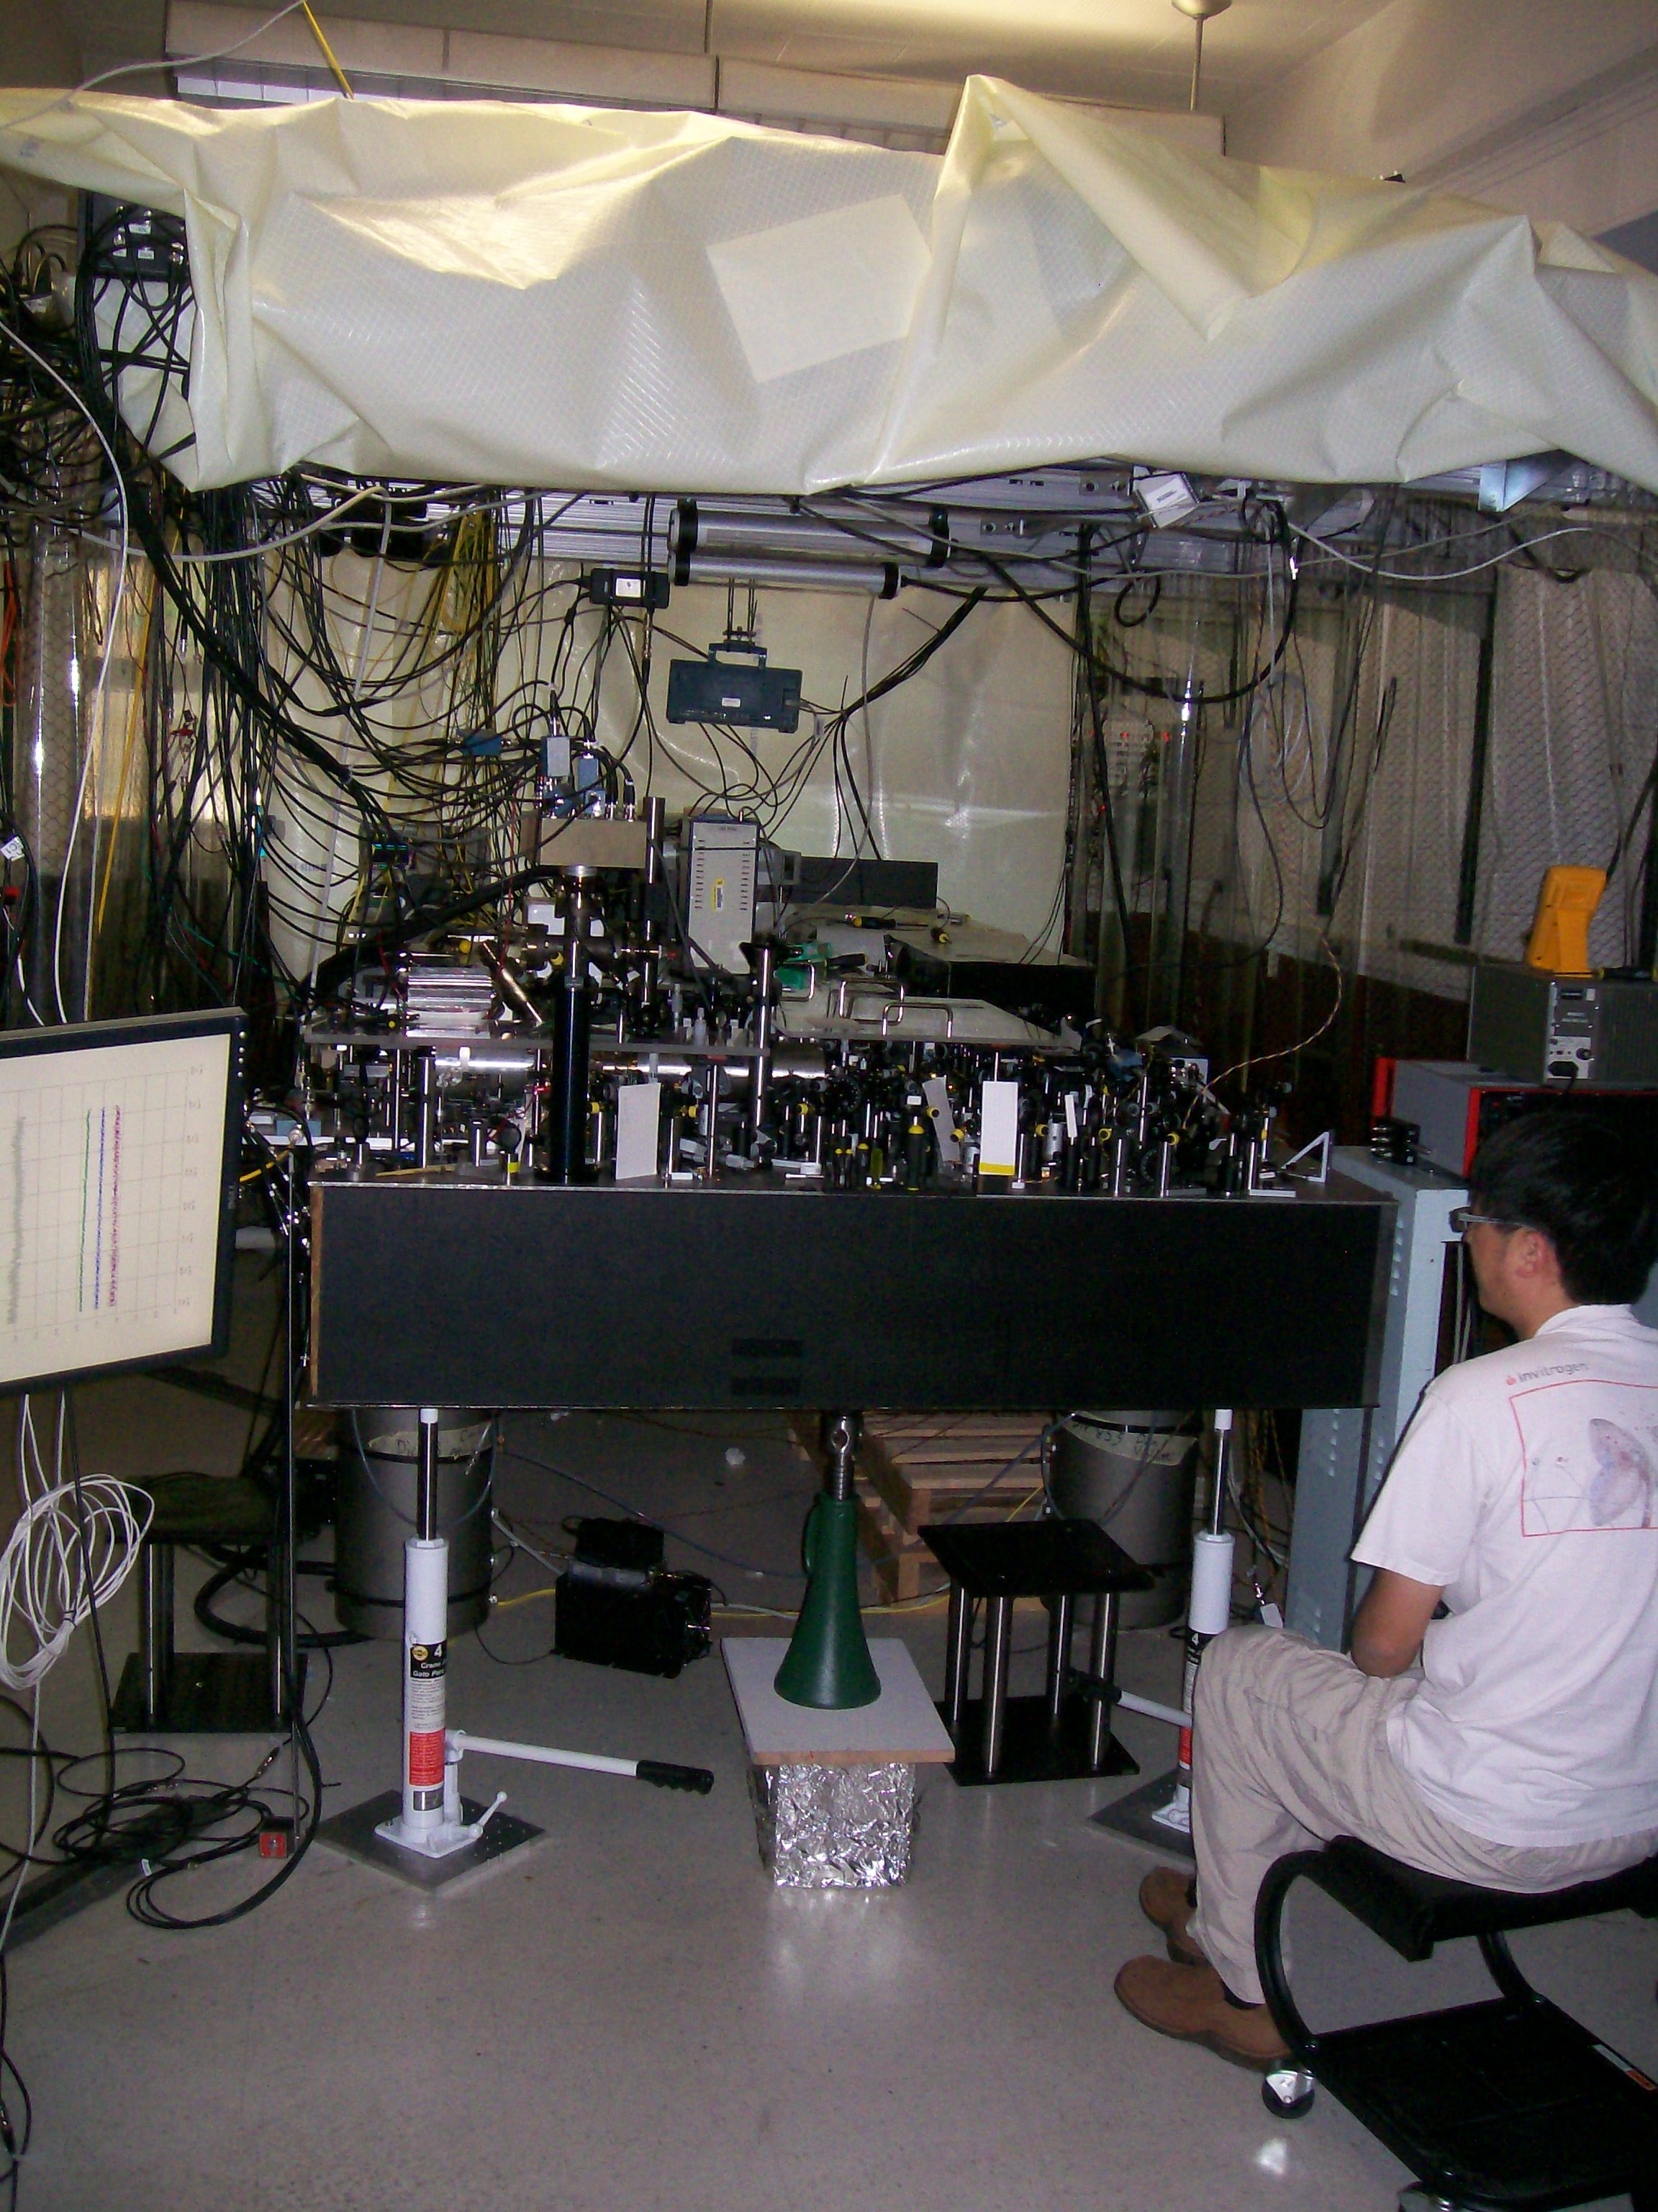

Slide 30
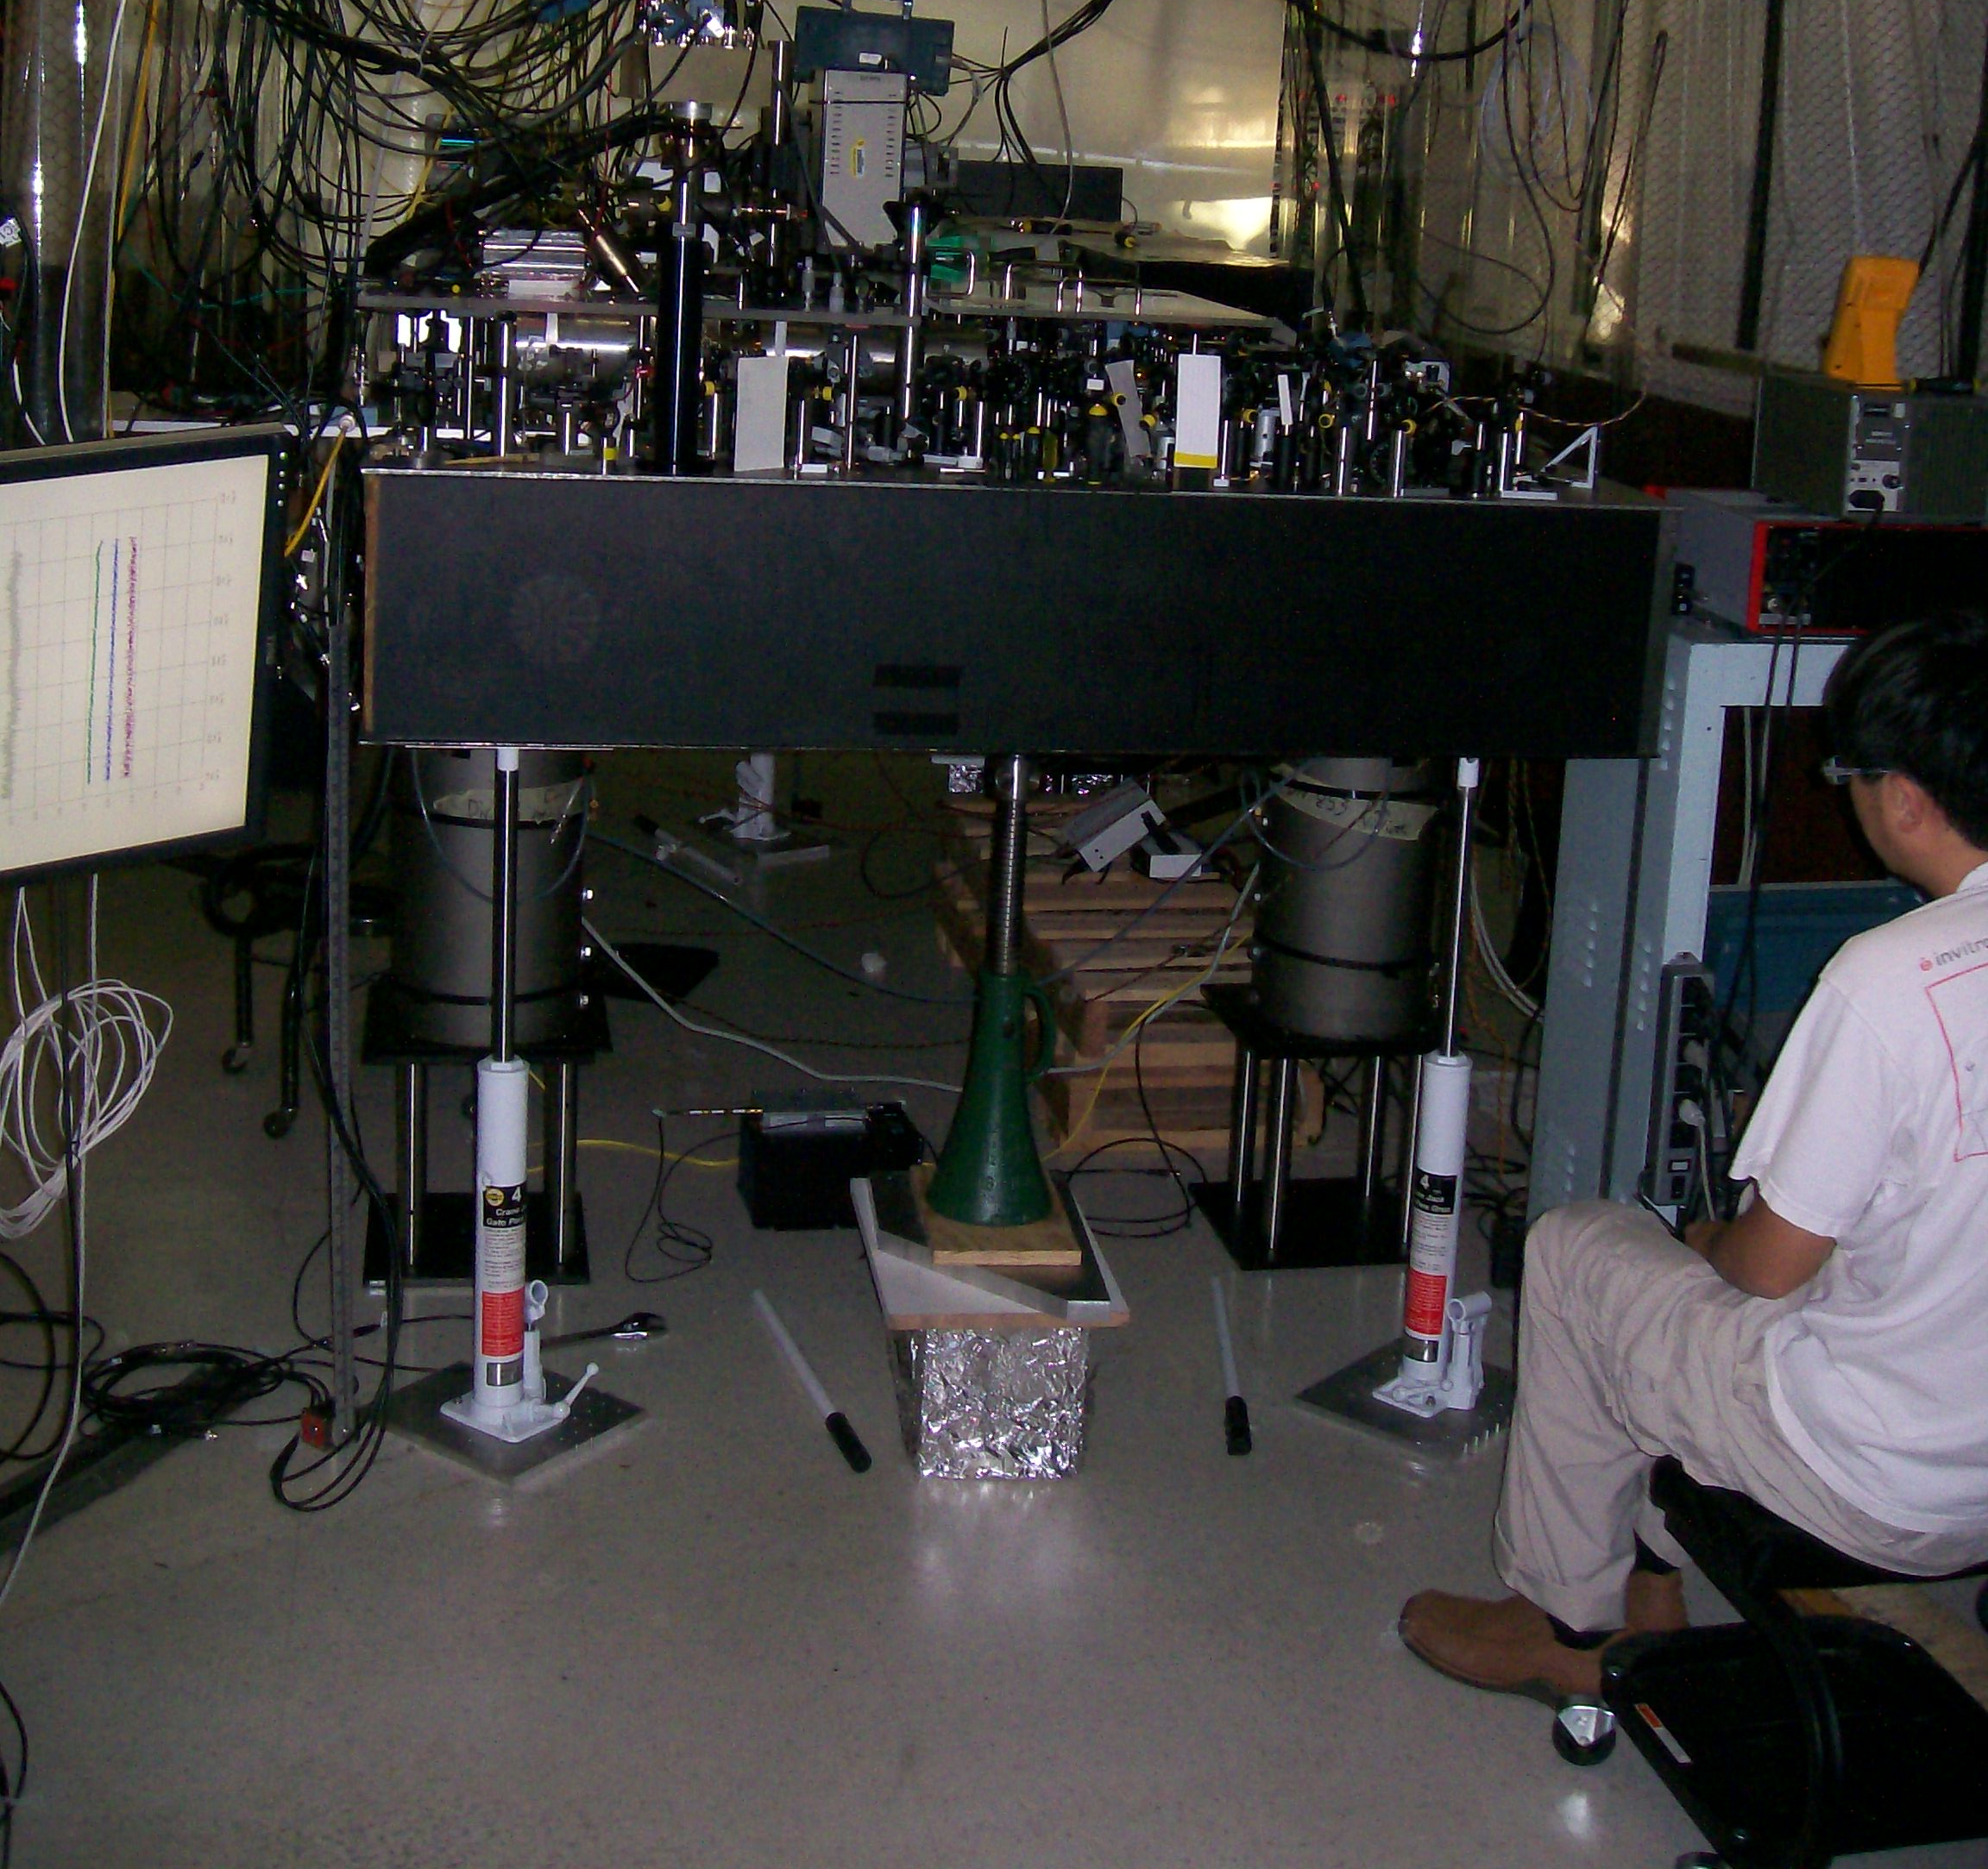
clock #1 raised 33 cm (~ 13 inches)
f₁/f₂ = 1.000 000 000 000 000 041(16)

Slide 31
Moving target!
Jun Ye’s group (JILA), Sr neutral atoms in optical lattice:
Δf/f₀(systematic) = 6.4 x 10⁻¹⁸
(B. J. Bloom et al., Nature 506, 71 (2014))
Δ T ≅ 30 mK
PTB, Braunschweig, Germany
Δ f/f₀(systematic) = 3.3 x 10⁻¹⁸
(unpublished)
weak (octupole) transition, laser Stark shifts, …
H. Katori group (Riken) Sr neutral atoms in optical lattice
Δ f/f₀(systematic) = 7.2 x 10⁻¹⁸ (arXiv:1405.4071)
2.4

Slide 32
Future?
* “Navigation” at < 1 cm scale:
- Measure earth strain – earthquake prediction
- geodesy: map earth via gravitational red shift
* Fundamental science:
- are the strengths of the basic forces really
constant in time?
- possible deviations from Einstein’s
general relativity?

Slide 33
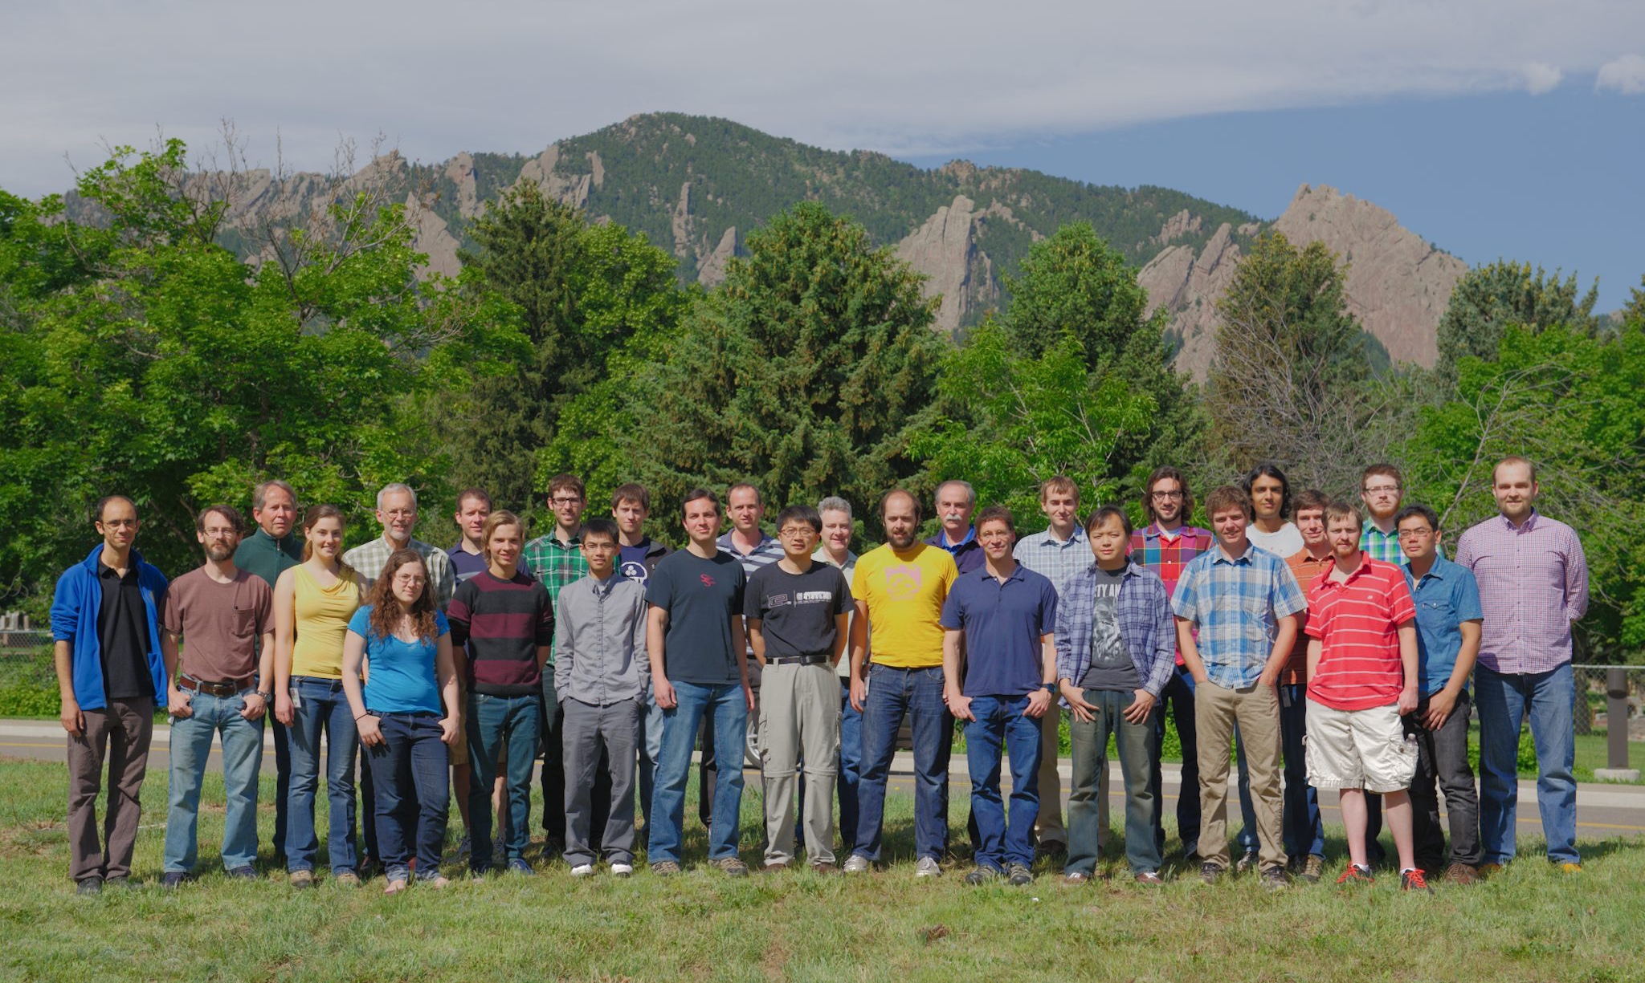






NIST “IONS” June 2014
Jim Bergquist, John Bollinger, Joe Britton, Justin Bonet, Ryan Bowler, John Gaebler, Andrew Wilson, Dave Wineland, David Leibrandt, Peter Burns, Raghu Srinivas, Shon Cook, Robert Jordens
David Hume Ting Rei Tan
Shlomi Kotler, Dustin Hite, Katie McCormick ,Susanna Todaro, Leif Waldner, Yiheng Lin, Daniel Slichter, James Chou, David Allcock, Didi Leibfried, Jwo-Sy Chen, Sam Brewer, Kyle McKay
Not pictured: Brian Sawyer, Till Rosenband, Wayne Itano, Dave Pappas, Bob Drullinger

